Slide 1
Software Construction Laboratory CS35L – Lab 1
Course Webpage: https://web.cs.ucla.edu/classes/fall18/cs35L/index.html
TA: Zhiyi Zhang
Email: zhiyi@cs.ucla.edu
Webpage: https://zhiyi-zhang.com

Slide 2
Session 10-1: Review
Week 1: Linux and Shell
Week 2: Shell Script and Regular Expression
Week 3: Compilation, Makefile, Diff and Patch, Python
Week 4: Debugging and C

Slide 3
Week 1: Linux and Shell

Slide 4
GNU/Linux
Open-source operating system
Kernel: core of operating system
Allocates time and memory to programs
Handles file system and communication between software and hardware
Shell: interface between user and kernel
Interprets commands user types in
Takes necessary action to cause commands to be carried out
Programs
Notes:
GNU /ɡnuː/ ( listen) is an operating system and an extensive collection of computer software. GNU is composed wholly of free software, most of which is licensed under the GNU Project's own General Public License (GPL).
GNU is a recursive acronym for "GNU's Not Unix!", chosen because GNU's design is Unix-like, but differs from Unix by being free software and containing no Unix code. The GNU project includes an operating system kernel, GNU HURD, which was the original focus of the Free Software Foundation (FSF).However, non-GNU kernels, most famously Linux, can also be used with GNU software; as the Hurd kernel is not yet production-ready,^{[20]} this is how the GNU system is usually used. The combination of GNU software and the Linux kernel is commonly known as Linux.

Slide 5
Files and Processes
Everything is either a process or a file:
Process: an executing program identified by PID
File: collection of data
A document
Text of program written in high-level language
Executable
Directory
Devices

Slide 6
Absolute Path vs. Relative Path
Absolute Path (green)
/home/laker/README
Relative Path (blue)
You pwd: /home/laker
doc/game2
/
root
bin
dev
home
usr
tmp
lakers
celtics
bulls
lib
README
music
doc
game1
game2

Slide 7
Shell commands you should be familiar with
pwd
cd
mv
cp
rm
mkdir
ls
ln
touch
find
whatis
whereis
man
ps
kill
diff
wget

Slide 8
Soft Link v.s. Hard Link
Hard
Notes:
The inode is a data structure in a Unix-style file systemwhich describes a filesystem object such as a file or a directory. Each inode stores the attributes and disk block location(s) of the object’s data.
Filesystem object attributes may include metadata (times of last change,[2]access, modification), as well as owner and permission data.
Create two files
$ touch blah1 $ touch blah2
Fill contents into the files and print them
$ echo "Cat" > blah1 $ echo "Dog" > blah2
$cat blah1; cat blah2
Cat
Dog
Create links
$ ln blah1 blah1-hard $ ln -s blah2 blah2-soft $ ls –l
blah1 blah1-hard blah2 blah2-soft -> blah2
Change the original file
$ mv blah1 blah1-new $ cat blah1-hard
Cat
$ mv blah2 blah2-new $ cat blah2-soft
cat: blah2-soft: No such file or directory

Slide 9
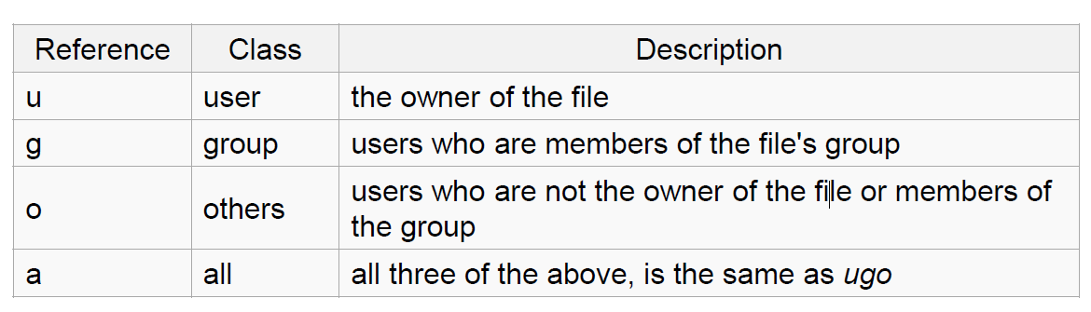
chmod command

Slide 10
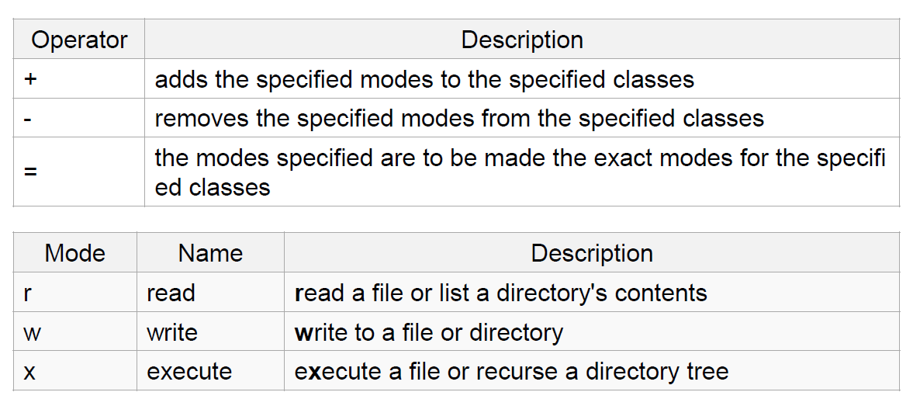
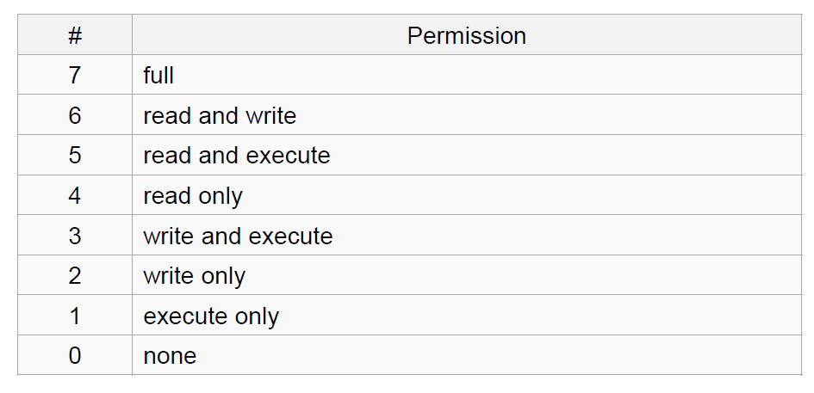
chmod with symbolic and numeric operators

Slide 11
Week 2: Shell Script and Regular Expression

Slide 12
Environment Variables
Definition
Variables that can be accessed from any child process
Common ones:
HOME: path to user’s home directory
PATH: list of directories to search in for command to execute
Change value:
export VARIABLE=…
Notes:
PATH=$PATH:~/opt/bin
PATH=~/opt/bin:$PATH
depending on whether you want to add ~/opt/bin at the end (to be searched after all other directories, in case there is a program by the same name in multiple directories) or at the beginning (to be searched before all other directories).

Slide 13
locale command
Set of parameters that define a user’s cultural preferences
Language
Country
Other area-specific things
Prints information about the current locale environment to standard output
Locale Settings Can Affect Program Behavior

Slide 14
sort, comm, and tr
sort: sorts lines of text files
Usage: sort [options] [FILE]
Commonly used flag: -u for unique keys
Sort order depends on locale, e.g., C locale: ASCII sorting
comm: compare two sorted files line by line
Usage: comm [options] FILE1 FILE2
Comparison depends on locale
tr: translate or delete characters
Usage: tr [options] set1 [set2]
Notes:
recipe.txt:
All-Purpose Flour
Baking Soda
Bread
Brown Sugar
Chocolate Chips
Eggs
Milk
Salt
Vanilla Extract
White Sugar
Shopping-list.txt:
All-Purpose Flour
Bread
Brown Sugar
Chicken Salad
Chocolate Chips
Eggs
Milk
Onions
Pickles
Potato Chips
Soda Pop
Tomatoes
White Sugar
echo "welcome to cs35l" | tr "[a-z]" "[A-Z]"

Slide 15
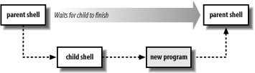
Shell Scripts: First Line
A shell script file is just a file with shell commands
When shell script is executed, a new child “shell” process is spawned to run it
The first line is used to state which child “shell” to use
#! /bin/sh
#! /bin/bash
Notes:
In computing, a shebang is the character sequence consisting of the characters number sign and exclamation mark (#!) at the beginning of a script.
#!interpreter [optional-arg]
in which interpreter is an absolute path to an executable program.

Slide 16
Variables in Shell Scripts
Declared using [var_name]=[value]
Example: var=“hello”
Notice there is no space in between
Referenced using $[var_name]
Example: echo $var
Notes:
#!/bin/sh message="HELLO WORLD!!!" echo $message

Slide 17
Array in Shell Scripts
declare –a ARRAY to declare an array called ARRAY
ARRAY[n] to access the nth value
${ARRAY[@]} to return all the values in the array called ARRAY
$[#ARRAY[@]] to return the size of the array called ARRAY
$[#ARRAY[n]] to return the length of the nth element in the array called ARRAY
unset ARRAY to delete the array
unset ARRAY[n] to delete the nth element

Slide 18
Accessing Arguments in Shell Script
Positional parameters represent a shell script’s command-line arguments
echo $1
For historical reasons, enclose the number in braces if it’s greater than 9
echo ${10}
Notes:
echo first arg is $1
echo tenth arg is ${10}

Slide 19
Quotes in Shell Script: Three Types of Quotes
Single quotes ' '
Do not expand at all, literal meaning
echo ' $HOME' will output $HOME
Double quotes " "
Weak quote. Expand backticks and $
echo "$HOME" will output your HOME directory
Backticks ` ` or $()
Expand as shell commands
echo $(ls) will output the output from ls command
echo `ls` will output the output from ls command

Slide 20
If Statement
If statements use the test command or [ ]
In fact, [] will invoke test command
“man test” to check the syntax of expression
Support boolean operations: AND: &&, OR: ||
if [ <test> ]
then
<commands>
elif [ <test> ]
then
<commands>
else
<commands>
fi
if [ <test> ]
then
<commands>
fi
if [ <test> ]
then
<commands>
else
<commands>
fi

Slide 21
Loop in Shell Script
#! /bin/bash
COUNT=6
while [ $COUNT -gt 0 ]
do
echo "Value: $COUNT"
let COUNT=COUNT-1
done
while loop
while [ <test> ]
do
<commands>
done
for loop
for var in <list>
do
<commands>
done
#! /bin/bash
for var in `ls`
do
echo $var
done
Notes:
The “let” command is used to do arithmetic
var will refer to each word in ls output

Slide 22
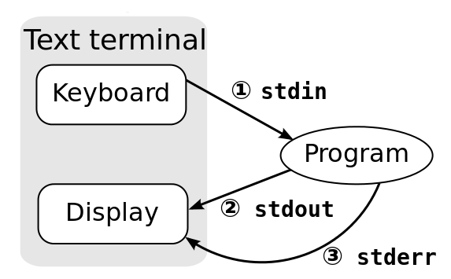
Standard Input and Output Streams
Every program has these 3 streams to interact with the world
stdin (0): contains data going into a program
stdout (1): where a program writes its output data
stderr (2): where a program writes its error messages

Slide 23
Redirection and Pipelines
program < file redirects file to programs’s stdin:
E.g. cat <fileA
program > file redirects program's stdout to file:
E.g., cat <fileA >fileB
program >> file appends program’s stdout to file
program1 | program2 assigns stdout of program1 as the stdin of program2;
E.g., cat <fileA | sort >fileB
Notes:
program 2> file redirects program's stderr to file:
E.g., cat <file 2>file2

Slide 24
Regular Expressions
Notation that lets you search for text with a particular pattern:
Strings that starts with the letter a, ends with three uppercase letters
Strings that are in the form of [letters numbers]@[letters numbers].[letters]
Learn Regular Expressions with simple, interactive exercises.
Simple regex tutorial https://regexone.com/

Slide 25
Regular Expressions
Character | Meaning in a pattern
\ | Usually, turn off the special meaning of the following character. Occasionally, enable a special meaning for the following character, such as for \(...\) and \{...\}.
. | Dot sign. A wildcard. Match any single character except NULL. Individual programs may also disallow matching newline.
* | (Kleene) Star sign. Match any number (or none) of the single character that immediately precedes it.
^ | Hat sign. This matches the following regular expression at the beginning of the line or string.
$ | Dollar sign. Match the preceding regular expression at the end of the line or string.
Notes:
In the POSIX standard, Basic Regular Syntax (BRE) requires that the metacharacters ( ) and { } be designated \(\) and \{\}, whereas Extended Regular Syntax (ERE) does not.
ERE adds ?, +, and |, and it removes the need to escape the metacharacters ( ) and { }, which are required in BRE

Slide 26
Regular Expressions
Character | Meaning in a pattern
[...] [^…] | Square brackets. This matches any one of the enclosed characters. A hyphen (-) indicates a range of consecutive characters. A hat (^) as the first character in the brackets reverses the sense: it matches any one character not in the list. All other metacharacters are treated as members of the list (i.e., literally).
\{m, n\}, {m, n} | Curly braces notation. This matches a range of occurrences of the single character that immediately precedes it. \{m\} matches exactly m occurrences. \{n,\} matches at least n occurrences. \{n,m\} matches any number of occurrences between n and m. (n and m must be between 0 and RE_DUP_MAX (min: 255), inclusive)
\( \), () | Save the pattern enclosed between \(\) in a special holding space. Up to nine subpatterns can be saved on a single pattern. The text matched by the subpatterns can be reused later by the escape sequences \1 to \9. For example, \(ab\).*\1 matches two occurrences of ab, with any number of characters in between.

Slide 27
Examples
Expression | Matches
regex | regex, anywhere on a line
^regex | regex, at the beginning of a line
regex$ | regex, at the end of a line
^regex$ | A line containing exactly regex, and nothing else
[Rr]egex | Regex, or regex, anywhere on a line
reg.ex | reg + any character + ex, anywhere on a line. E.g., regaex, regBex, and so on
reg.*ex | reg + any sequence of zero or more characters + ex, anywhere on a line. E.g., regex, reggex, regABC123ex, and so on
reg{2,5}ex | re + repetitive g for 2 to 5 times + ex, anywhere on a line. E.g., reggex, regggex, reggggex, regggggex

Slide 28
Regular Expressions
Character | Meaning in a pattern
\n | Backreference. Replay the nth subpattern enclosed in \( and \) into the pattern at this point. n is a number from 1 to 9, with 1 starting on the left.
+ | Match one or more instances of the preceding regular expression.
? | Match zero or one instances of the preceding regular expression. E.g.,
| | Match the regular expression specified before or after. Denote different possible sets of characters. E.g., I love (cats|dogs) matches I love cats and I love dogs.
( ()) | Apply a match to the enclosed group of regular expressions. E.g. Use (IMG(d+))\.png to capture both IMG1.png and 1.

Slide 29
Matching Multiple Characters with One Expression
?: one or zero
+: one or more
*: zero or more
{n}: n times
{n,}: at least n times
{m, n}: between m and n

Slide 30
4 Basic Concepts of Regular Expression
Quantification
How many times of previous expression?
Most common quantifiers: ?(0 or 1), *(0 or more), +(1 or more)
Grouping
Which subset of previous expression?
Grouping operator: ()
Alternation
Which choices?
Operators: [] and |
Anchors
Where?
Characters: ^ (beginning) and $ (end)

Slide 31
POSIX Bracket Expressions
Class | Matching characters | Class | Matching characters
[:alnum:] | Alphanumeric characters | [:lower:] | Lowercase characters
[:alpha:] | Alphabetic characters | [:print:] | Printable characters
[:blank:] | Space and tab characters | [:punct:] | Punctuation characters
[:cntrl:] | Control characters | [:space:] | Whitespace characters
[:digit:] | Numeric characters | [:upper:] | Uppercase characters
[:graph:] | Nonspace characters | [:xdigit:] | Hexadecimal digits

Slide 32
Searching for Text
grep: Uses basic regular expressions (BRE)
“meta-characters ?, +, {, |, (, and ) lose their special meaning; instead use the backslashed versions” – `man grep`
egrep (or grep -E): Uses extended regular expressions (ERE) – no backslashes needed
fgrep (or grep -F): Matches fixed strings instead of regular expressions.
Notes:
$ who Who is logged on
tolstoy tty1 Feb 26 10:53
tolstoy pts/0 Feb 29 10:59
tolstoy pts/1 Feb 29 10:59
tolstoy pts/2 Feb 29 11:00
tolstoy pts/3 Feb 29 11:00
tolstoy pts/4 Feb 29 11:00
austen pts/5 Feb 29 15:39 (mansfield-park.example.com)
austen pts/6 Feb 29 15:39 (mansfield-park.example.com)
$ who | grep -F austen Where is austen logged on?
austen pts/5 Feb 29 15:39 (mansfield-park.example.com)
austen pts/6 Feb 29 15:39 (mansfield-park.example.com)

Slide 33
sed command to replace text
Now you can extract, but what if you want to replace parts of text? Use sed command!
sed 's/regExpr/replText/[g]’
Example:
$ echo "Let's try unix" | sed 's/unix/linux/g’
$ echo "Welcome To CS35L" | sed 's/[0-9]/1/g’
$ echo $PATH | sed 's/:.*//'

Slide 34
Review Your sameln Shell Script

Slide 35
Week 3: Compilation, Makefile, Diff and Patch, Python

Slide 36
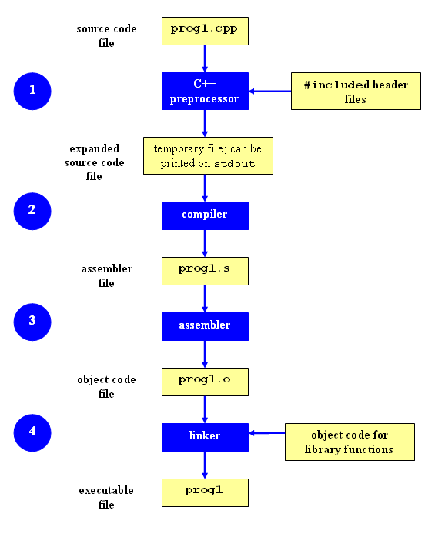
Compilation Process
Preprocessing (Preprocessed Code)
Include Headers
Replace symbolic constants
Compilation (Assembly Code)
Preprocessed code is translated to assembly instructions specific to the target processor architecture
Assembly (Object Code)
To object code. The output consists of actual instructions to be run by the target processor.
Linking (Executable File)
Link the missing pieces of the program, e.g., dynamic link libraries
Notes:
g++ -E example.cpp
Will output the preprocessed code
g++ -S example.cpp
Will generate the assembly instructions
g++ -c example.cpp
Will generate object code
hexdump example.o
g++ -o example example.cpp

Slide 37
Command-Line Compilation
shop.cpp
#includes shoppingList.h and item.h
shoppingList.cpp
#includes shoppingList.h
item.cpp
#includes item.h
How to compile?
g++ -Wall shoppingList.cpp item.cpp shop.cpp –o shop

Slide 38
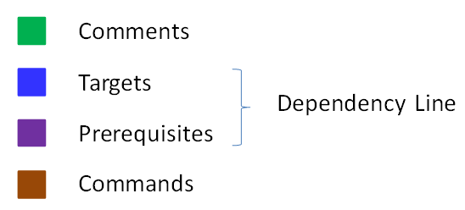
Makefile Example
# Makefile - A Basic Example
all : shop #usually first
shop : item.o shoppingList.o shop.o
g++ -g -Wall -o shop item.o shoppingList.o shop.o
item.o : item.cpp item.hpp
g++ -g -Wall -c item.cpp
shoppingList.o : shoppingList.cpp shoppingList.hpp
g++ -g -Wall -c shoppingList.cpp
shop.o : shop.cpp item.hpp shoppingList.hpp
g++ -g -Wall -c shop.cpp
clean :
rm -f item.o shoppingList.o shop.o shop
Rule

Slide 39
Diff command to generate a patch
diff [original file] [updated file]
Understand the output:
Line number, e.g., 12,15
Operations: c (replace), d (delete), a (append)
Create a patch:
diff [original file] [updated file] > [blabla].patch

Slide 40
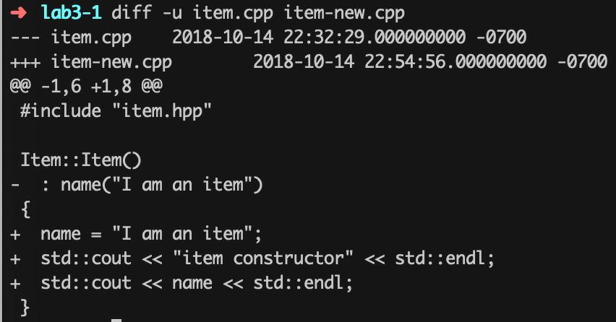
Unified Format in diff
diff –u [original file] [updated file]
--- path/to/original_file
+++ path/to/modified_file
@@ -l, s _l, s @@
@@ begin of a hunk
l: beginning of a hunk
S: number of lines the change hunk applies to for each file
A line with a
- sign was deleted from the original
+ sign was added to the original
stayed the same
Notes:
The diff command can also output the differences in another format: the unified format. This format is more compact, as it omits redundant context lines and groups things like line number instructions. However, this format is currently only supported by GNU diff and patch.

Slide 41
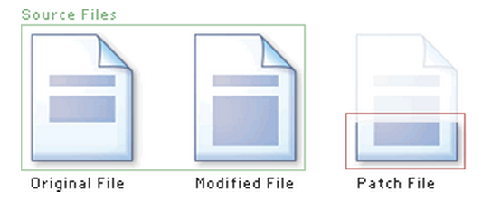
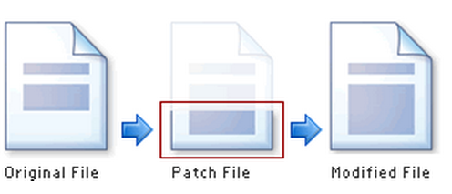
Applying the Patch to One File
Syntax: patch [original file] -i [patch file] -o [updated file]
patch command will apply the patch file to the original file and create an updated file

Slide 42
Applying the Patch to One Directory
Syntax: patch -p[num] < [patch file]
patch command will apply the patch file to the current directory
-p is used to strip the smallest prefix containing num leading slashes from each file name found in the patch file.
Example: in the patch: ---/usr/tmp/project/file1~ +++/usr/tmp/project/file1
When use -p3, the file path becomes file1 (use this when you call patch command in /usr/tmp/project directory)

Slide 43
Python
A scripting language
An object-oriented language: classes, member functions, etc.
Interpreted programming language
Execute instructions directly and freely by interpreter
No need of previous compilation to make your code machine-language instructions
Super popular in both research and industry
One of the most popular language for machine learning and AI
Used by Google, Facebook, and other famous companies for their products
Notes:
Indentation to define blocks
Python variables do not need explicit declaration

Slide 44
Review Your shuf.py
Notes:
dict = {}
dict[‘hello’] = “world”
print dict[‘hello’]
del dict[‘hello’]

Slide 45
Week 4: Debugging and C

Slide 46
How to use GDB
Compile Program
Without debugging info: gcc [flags] <source files> -o <output file>
Check our previous slides (week 3) if you forgot this :D
With debugging info: gcc [other flags] –g <source files> -o <output file>
Produce debugging information that can be used by built-in debugger
Specify Program to Debug
Use gdb command with argument: gdb <executable>
Specify program in gdb: “gdb” and then (gdb) file <executable>

Slide 47
How to use GDB
Run your program
(gdb) run
(gdb) run [arguments]
When you are in GDB’s interactive shell
Tab to autocomplete, up-down arrow to recall history commands
help [command] to get help information of a command
Exit
(gdb) quit

Slide 48
How to use breakpoints
Setting breakpoints
(gdb) break file1.c:6
(gdb) break my_function
(gdb) break [position] if [expression]
Check the existing breakpoints
(gdb) info breakpoints
Or break or br or b

Slide 49
How to use breakpoints
Delete breakpoints
(gdb) delete [breakpoint_id]
Enable/Disable breakpoints
(gdb) disable/enable [breakpoint_id]
Ignore breakpoints for several times
(gdb) ignore [break_point_id] [iterations]

Slide 50
More commands when using GDB
Printing data of interest at run time
(gdb) print [format] [expression]
d, x, o, t for decimal, hexadecimal, octal, and binary notation
Watch changes to variables
(gdb) watch [var_name]
(gdb) rwatch [expression]
When a program stops at a breakpoint
(gdb) continue | step | next | finish
c or continue: debugger will continue executing until next breakpoint.
s or step: debugger will continue to next source line.
n or next: debugger will continue to next source line in the current (innermost) stack frame.
f or finish: debugger will resume execution until the current function returns. Execution stops immediately after the program flow returns to the function's caller
Notes:
The watch command sets a watchpoint on var_name. the debugger will stop the program when the value of var_name changes: both old and new values will be printed.
The debugger stops the program whenever the program reads the value of any object involved in the evaluation of expression

Slide 51
More commands when using GDB
List all functions in the program
(gdb) info functions
List the source code lines around the current line
(gdb) list

Slide 52
Brief Introduction to Process Memory
Stack
Push frame when function invoked
Pop frame when function returned
Stores local vars, return address, etc.
Heap
Dynamic memory allocation

Slide 53
Data types, pointers, struct
Basic data type
int
float
double
char
void
Pointers
<variable_type> *<name>
Struct
struct <name> { ... }

Slide 54
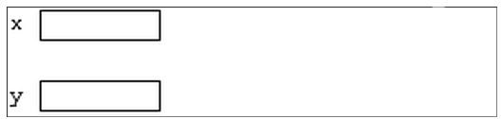
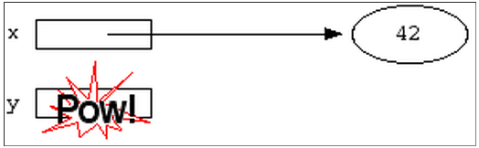
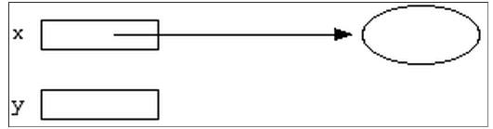
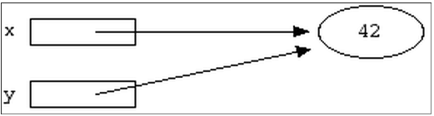
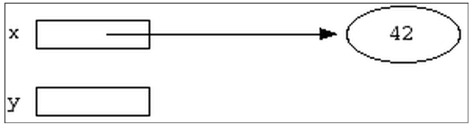
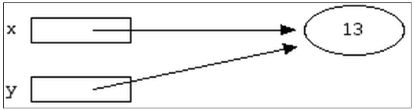
Pointer Example
int *x;
int *y;
*y = 13;
int var;
x = &var;
y = x;
*x = 42;
*x = 13;

Slide 55
Dynamic Memory Allocation
void *malloc (size_t size);
Allocates size bytes and returns a pointer to the allocated memory
void *realloc (void *ptr, size_t size);
Changes the size of the memory block pointed to by ptr to size bytes
void free (void *ptr);
Frees the block of memory pointed to by ptr

